Slide 1
Image Processing (CS313a) – Project
Manjot Singh - 2017330
Arnav deep - 2017316

Slide 2
A Shadow-Overlapping Algorithm for Estimating Building Heights From VHR Satellite Images
Objective:
To identify height of a building from it’s shadow on pan-sharpened VHR (Very High Resolution) satellite images.
The Procedure are mentioned in the following slides.

Slide 3
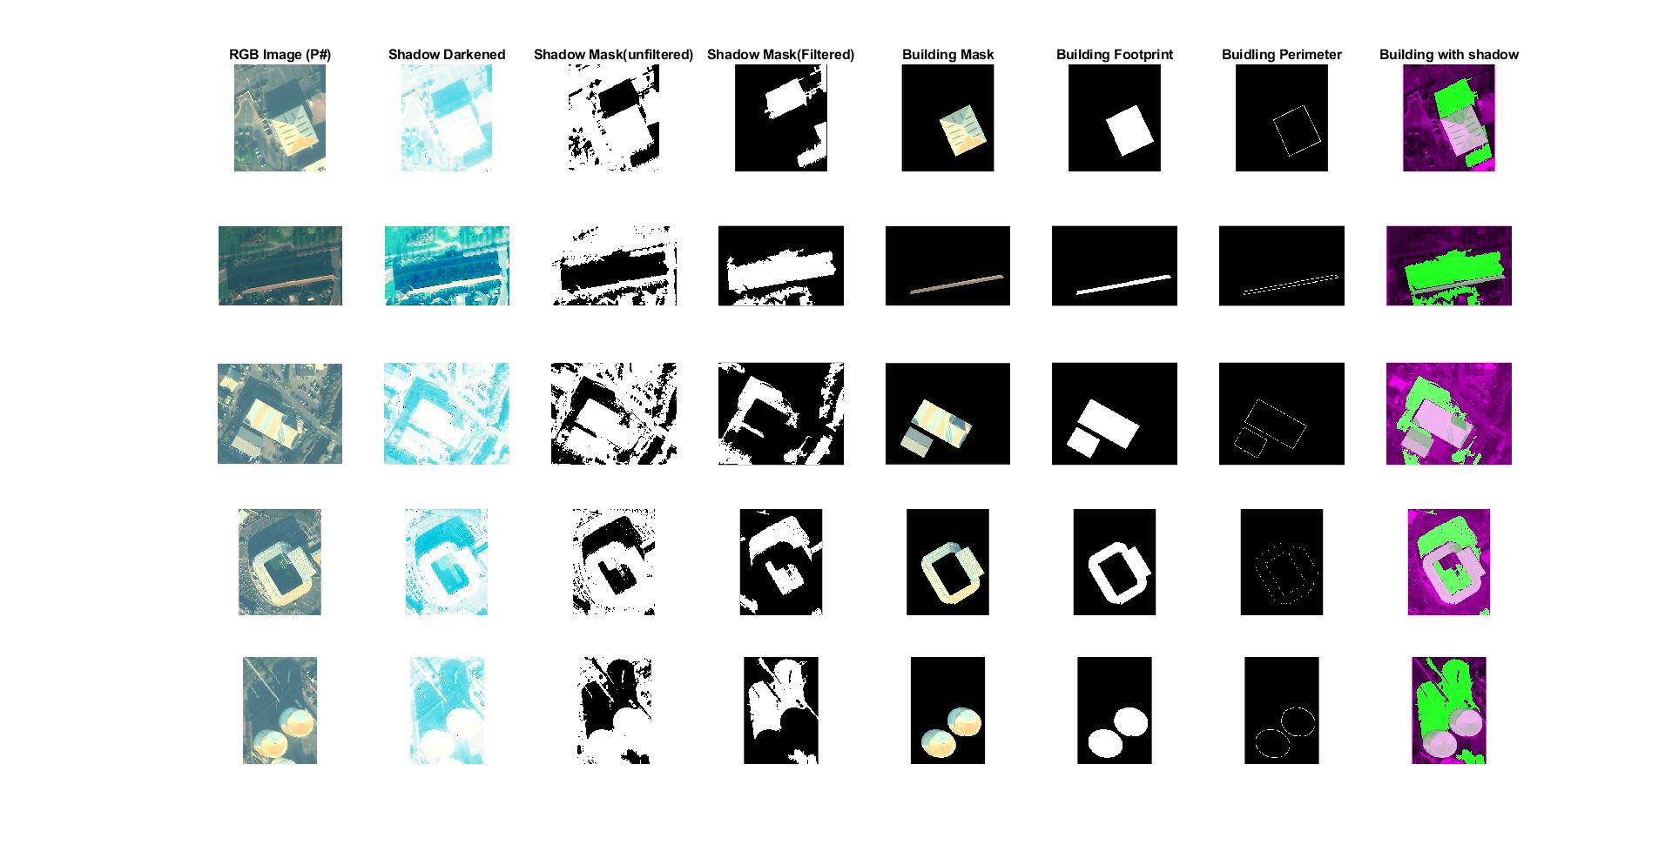
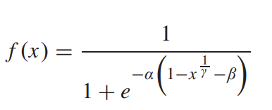

Step 1: Obtain Shadow Image
Non Linear Mapping Function used:
Resultant pixels form image V. NIR channel is taken from tiff file in the dataset.
D = V * NIR ; T = V / NIR
I_{S} is the shadow darkened image of the original, as shown.
Initial Image
I_{S}

Slide 4
Step 2: Create Initial Shadow Mask
Image Thresholding is applied to I_{s} and M_{SI} (Initial Shadow Mask) is obtained, which includes all the vegetation’s and other irrelavent small object’s shadow.
This gives an Initial Shadow Mask, M_{SI}, of the image, as shown.
I_{S}
M_{SI}

Slide 5
Step 3: Filtering M_{si}
Regions whose areas are less than a certain threshold are removed.
Shadow Mask, M_{S} (or actual shadow, S_{AC}), is obtained, as shown.
M_{SI}
M_{S}/S_{AC}

Slide 6
Step 4: Segmenting Image to obtain Building Mask
Image segmentation is performed to obtain the building mask.
Foreground is separated and background is removed.
Building Mask, M_{BI}, is obtained, as shown.
Initial Image
M_{BI}

Slide 7
Step 5: Binarize M_{BI}
Building Mask is converted to Black and White image.
Resulting image is the Building Mask, M_{B}, as shown.
M_{BI}
M_{B}

Slide 8
Step 6: Obtain Perimeter of Building, M_{BP}
Following operations are performed:
M_{BC} = 1 – M_{B}; M_{BA} = M_{BC} ⊕ O;
O is a 3×3 matrix of 1.
M_{BP} is obtained from intersection of M_{BA} with M_{BP}.
The resultant is the Building Perimeter, M_{BP}, as shown.
M_{B}
M_{BP}

Slide 9
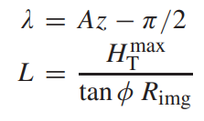
Step 7: Create Artificial Shadows of Buildings
Artificial Shadows, S_{AR}, of buildings are generated using a linear structuring element made by:
where, A_{Z} is the Azimuth angle = 173.2° (in metadata),
φ is the Solar Elevation = 16.3° (in metadata),
R_{img} is resolution of the image,
and, H_{T}^{max} is the maximum height threshold.
Using neighborhood from the structuring element above, S_{AR} is obtained, as shown.
M_{BI}
M_{B}
M_{BP}
S_{AR}

Slide 10

Step 8: Calculate Height Using Jaccard Index
Jaccard index between actual shadow, S_{M}, and generated artificial shadow, S_{AR}, is calculated for various heights (H_{t}^{min} to H_{t}^{max}).
This is done till an optimal Jaccard Index is found, and is used to calculate the optimal height.
S_{AC}
S_{AR}

Slide 11
The Complete Process

Slide 12
Results
The Jaccardian Index finds similarities between the Artificial Shadows and the Actual Shadow, and the height which gives the most similarity gives the optimal height of the building.

Slide 13
Thank You

